Slide 1
Adversarial Searching
Nirmala Shinde Baloorkar
Assistant Professor
Department of Computer Engineering

Slide 2
Outline
Game
MiniMax
Alpha Beta Pruning

Slide 3
Games in AI
In AI, “games” usually refers
Deterministic:
If the next state of environment is completely determined by current state and action executed by the agent (not probabilistic)
Turn-taking:
2 agents whose actions must alternate
Zero-sum games:
if one agent wins, the other loses
Perfect information:
fully observable
Notes:
2. Turn-Taking Games
In these games, two agents (players) take turns making moves.
This is different from real-time strategy games where actions may happen simultaneously.
Example: In Chess, one player moves a piece, then the other player responds.
Contrast:
Games like Rock-Paper-Scissors are simultaneous-move games, where both players make decisions at the same time.
3. Zero-Sum Games
A game is zero-sum if one player's gain is exactly equal to the other player’s loss.
This means the total payoff is always zero—there is no situation where both players benefit.
Example: In Chess, if one player wins, the other loses.
Contrast:
Non-zero-sum games, like the Prisoner's Dilemma, allow for cooperation where both players may benefit or suffer together.
4. Perfect Information
A game has perfect information if all players have full visibility of the game's state at all times.
There is no hidden information—every move is known by both players.
Example: Chess, Checkers, and Tic-Tac-Toe.
Contrast:
Imperfect information games, like Poker, involve hidden elements (e.g., the opponent's cards are not visible).

Slide 4
Other Games
 | deterministic | chance
perfect information | chess, checkers, go, othello | backgammon, monopoly
imperfect information | stratego | bridge, poker, scrabble, nuclear war
Notes:
1. Deterministic Games
A game is deterministic if the next state of the environment is completely determined by the current state and the action executed by the agent.
There is no randomness involved in how the game progresses.
Example: Chess and Tic-Tac-Toe are deterministic games because every move leads to a predictable result.
Contrast:
Stochastic games, like Poker or Backgammon, involve some level of randomness, often through dice rolls or shuffled cards.

Slide 5
Games as Search
States:
board configurations
Initial state:
the board position and which player will move
Successor function:
returns list of (move, state) pairs, each indicating a legal move and the resulting state
Terminal test:
determines when the game is over
Utility function:
gives a numeric value in terminal states
(e.g., -1, 0, +1 for loss, tie, win)
Notes:
1. States (Board Configurations)
A state in a game represents a possible configuration of the board.
For example, in Chess, a state is a snapshot of the board with all piece positions.
In Tic-Tac-Toe, a state is a 3x3 grid with Xs and Os in certain places.
2. Initial State
The initial state defines:
The starting position of the board.
Which player makes the first move (e.g., White in Chess or X in Tic-Tac-Toe).
3. Successor Function
This function generates all possible legal moves from a given state.
It returns a list of (move, state) pairs, where:
"Move" represents the action taken.
"State" is the new board configuration after making that move.
4. Terminal Test
Determines when the game is over.
A game reaches a terminal state when:
One player wins (e.g., checkmate in Chess, three-in-a-row in Tic-Tac-Toe).
The game ends in a draw (e.g., stalemate in Chess or a full Tic-Tac-Toe board with no winner).
5. Utility Function
Assigns a numerical value to terminal states to evaluate the outcome.
Examples:
Tic-Tac-Toe:
+1 → Win
0 → Tie
-1 → Loss
Chess:
+infinity → Winning position
-infinity → Losing position
0 → Draw
This utility function helps AI choose the best moves by maximizing its expected score.

Slide 6
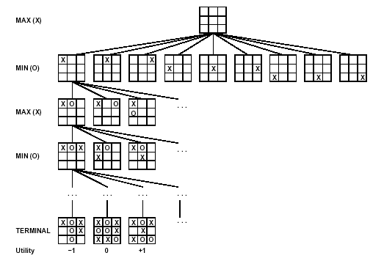
Games as Search (continued)
Notes:
A (partial) game tree for the game of tic-tac-toe. The top node is the initial state, and MAX moves first, placing an X in an empty square. We show part of the tree, giving alternating moves by MIN (O) and MAX (X), until we eventually reach terminal states, which can be assigned utilities according to the rules of the game.
https://www.slideshare.net/slideshow/minmax-and-alpha-beta-pruningpptx/262897912

Slide 7
Adversarial Search
A search when there is an "enemy" or "opponent" changing the state of the problem every step in a direction you “DO NOT”want.
Examples: Chess, business, trading, war.
You change state, but then you don't control the next state.
Opponent will change the next state in a way: unpredictable.
Min Max algorithm
Alpha beta pruning

Slide 8
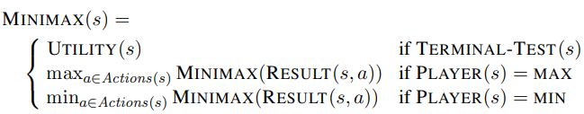
Adversarial
Adversarial Search for the minimax procedure works as follows:
It aims to find the optimal strategy for MAX to win the game.
It follows the approach of Depth-first search.
In the game tree, optimal leaf node could appear at any depth of the tree.
Propagate the minimax values up to the tree until the terminal node discovered.

Slide 9
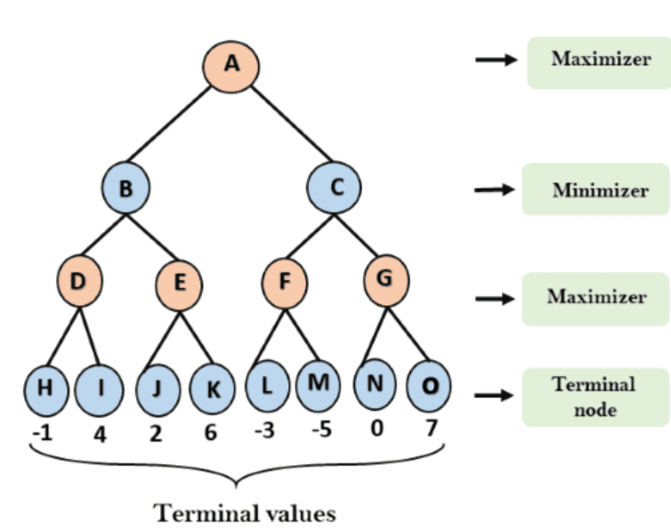
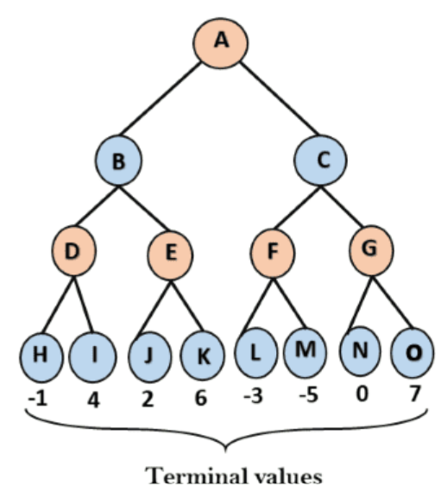
Example 1
Applies the utility function to obtain utility values for the terminal states. Let's assume the tree's initial state in the diagram below.
Min = + ∞
worst-case initial value = + infinity.
Max = - ∞
worst-case initial value = - infinity

Slide 10
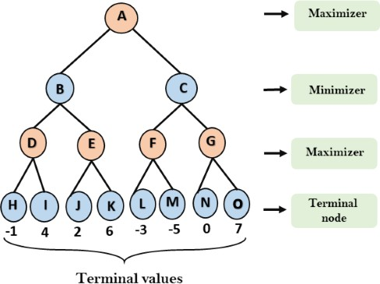
Example 1 – Step 2
The Maximizer assesses the utility value for each terminal state and compares these values against its initial utility. This allows it to determine the optimal values for the upper nodes, ultimately selecting the best possible option from all the available choices.
For node D max(-1,- -∞) => max(-1,4) = 4
For Node E max(2, -∞) => max(2, 6) = 6
For Node F max(-3, -∞) => max(-3,-5) = -3
For node G max(0, -∞) = max(0, 7) = 7
Notes:
For node D max(-1,- -∞) => max(-1,4) = 4
For Node E max(2, -∞) => max(2, 6)
= 6
For Node F max(-3, -∞) => max(-3,-5)
= -3
For node G max(0, -∞) = max(0, 7)
= 7

Slide 11
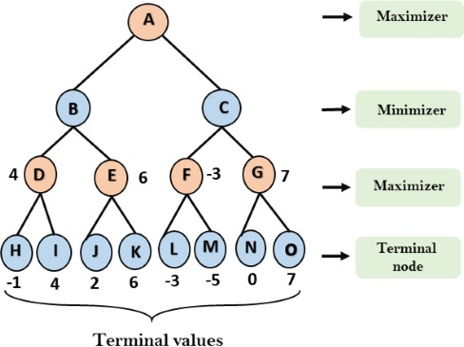
Example 1 – Step 3
Now, the Minimizer assesses the utility values of the current nodes and uses them to calculate the values for the nodes in the layer above. This process helps determine the best outcomes at the next higher level of the decision tree
For node B= min(4,6) = 4
For node C= min (-3, 7) = -3
Notes:
For node B= min(4,6) = 4
For node C= min (-3, 7) = -3

Slide 12
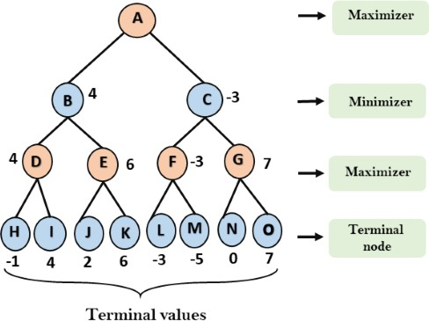
Example 1 – Step 4
Now, it's the Maximizer's turn to act. It evaluates the maximum value among all the nodes to determine the maximum value for the root node
For node A= max(4,-3) = 4
Notes:
For node A max(4, -3)= 4

Slide 13
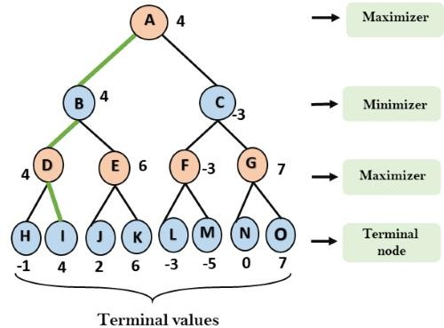
Example 1 - Solution

Slide 14
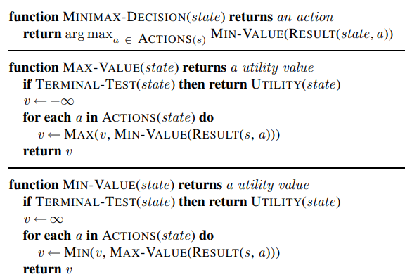
MiniMax Algorithm
Notes:
An algorithm for calculating minimax decisions. It returns the action corresponding to the best possible move, that is, the move that leads to the outcome with the best utility, under the assumption that the opponent plays to minimize utility. The functions MAX-VALUE and MIN-VALUE go through the whole game tree, all the way to the leaves, to determine the backed-up value of a state. The notation argmaxa ∈ S f(a) computes the element a of set S that has the maximum value of f(a).

Slide 15
Mini-Max Properties
Complete? Yes, if tree is finite
Optimal?
Against an optimal opponent? Yes
Time complexity? O(b^{m})
Space complexity? O(bm)
Notes:
Time complexity- Because it executes DFS for the game-tree, the time complexity of the Min-Max algorithm is O(b^{m}), where b is the game-branching tree's factor and m is the tree's maximum depth.
Space Complexity- Mini-max method has a space complexity that is similar to DFS, which is O(bm).

Slide 16
Application of MiniMax
Game Theory
AI in Robotics
Economics
Decision-making in AI
Notes:
Game Theory: It’s extensively used in strategic games like chess, checkers, and tic-tac-toe.
AI in Robotics: Mini-Max helps robots make optimal decisions when faced with adversarial situations.
Economics: The algorithm is used in decision-making models where two entities with conflicting goals must make optimal moves.
Decision-making in AI: Beyond games, Mini-Max is applied in AI systems that require optimal decision-making in competitive environments​.

Slide 17
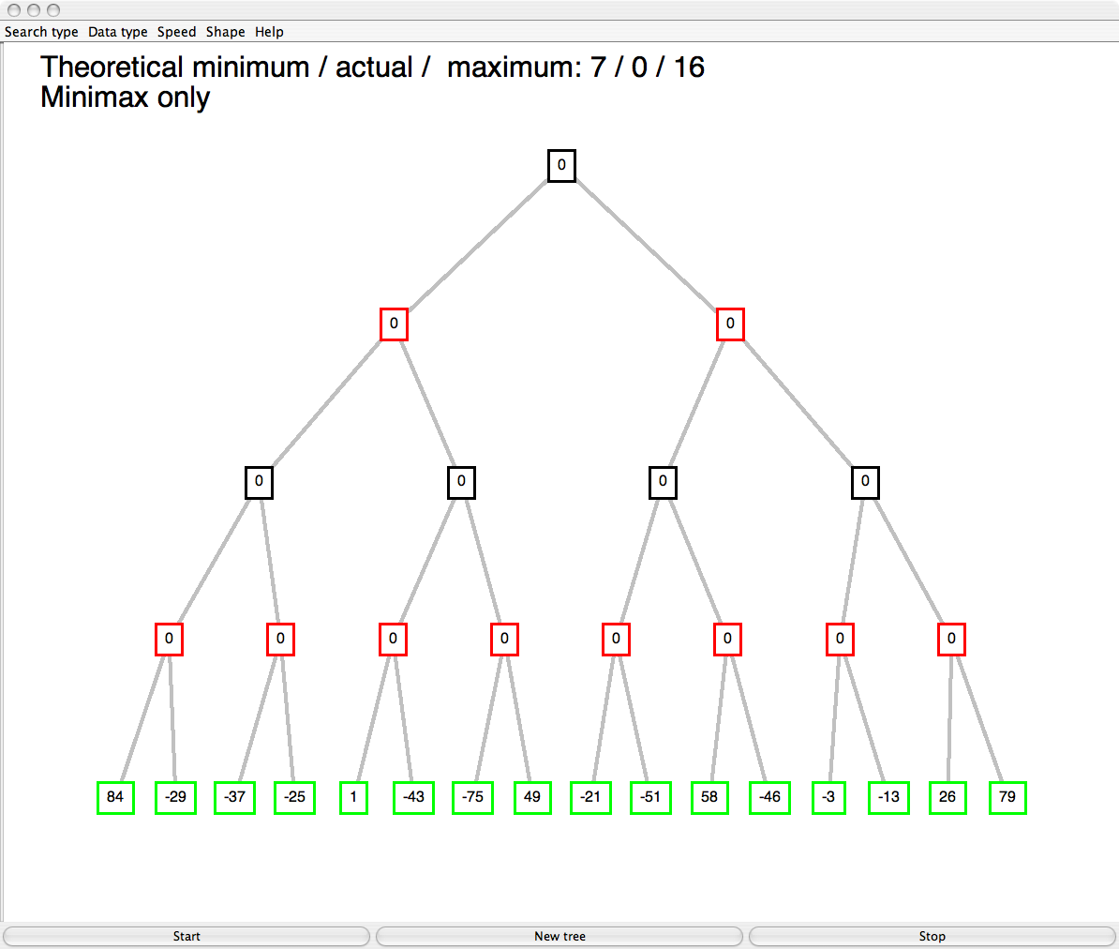
Example 2
max
min
max
min
© Patrick Winston

Slide 18
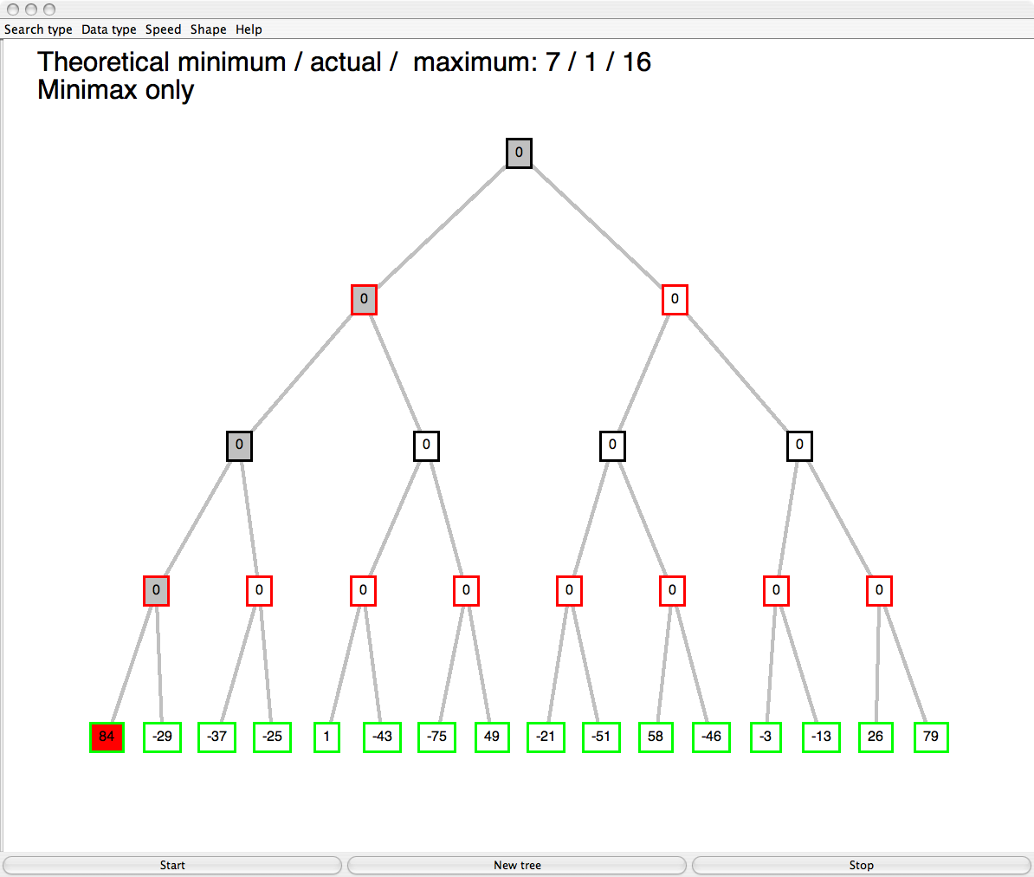
max
min
max
min
© Patrick Winston

Slide 19
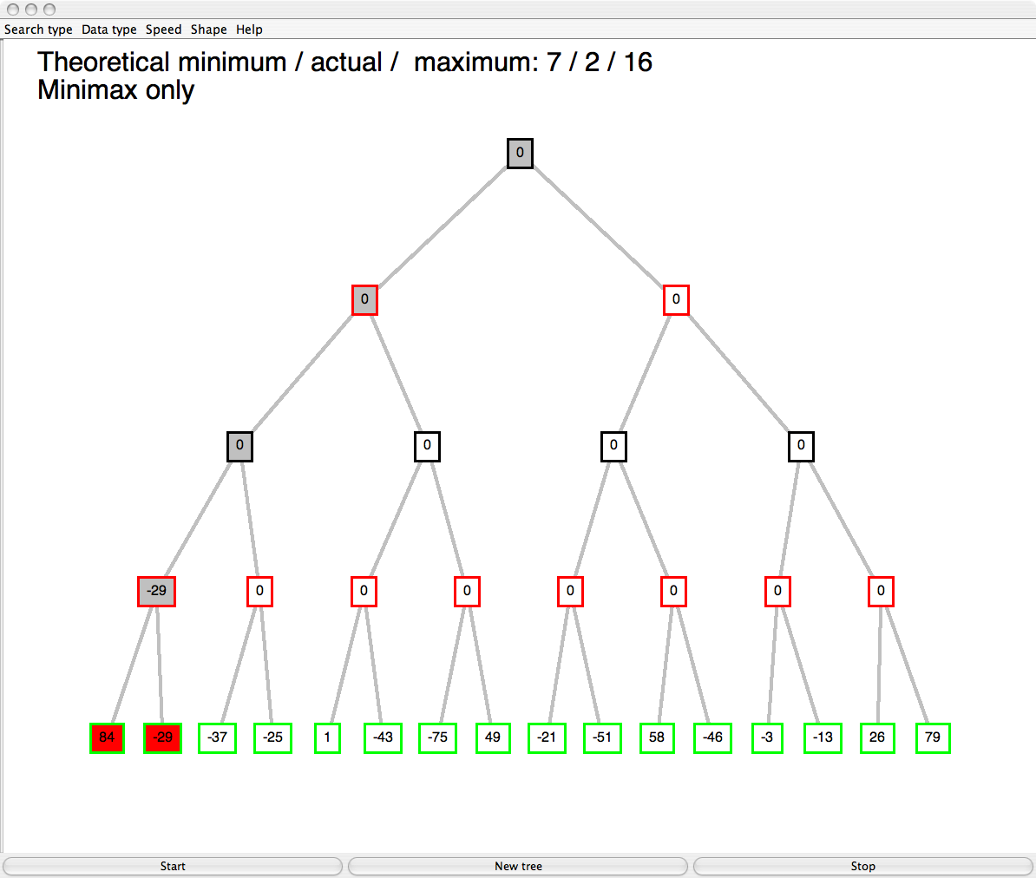
max
min
max
min
© Patrick Winston

Slide 20
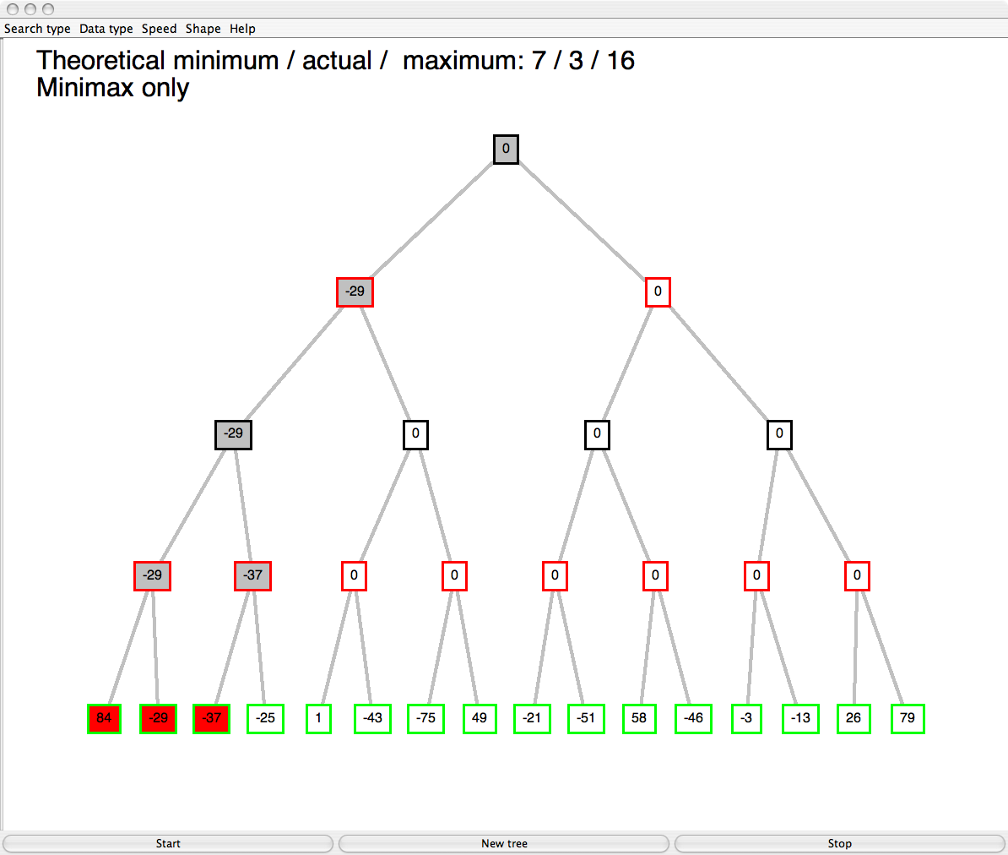
max
min
max
min
© Patrick Winston

Slide 21
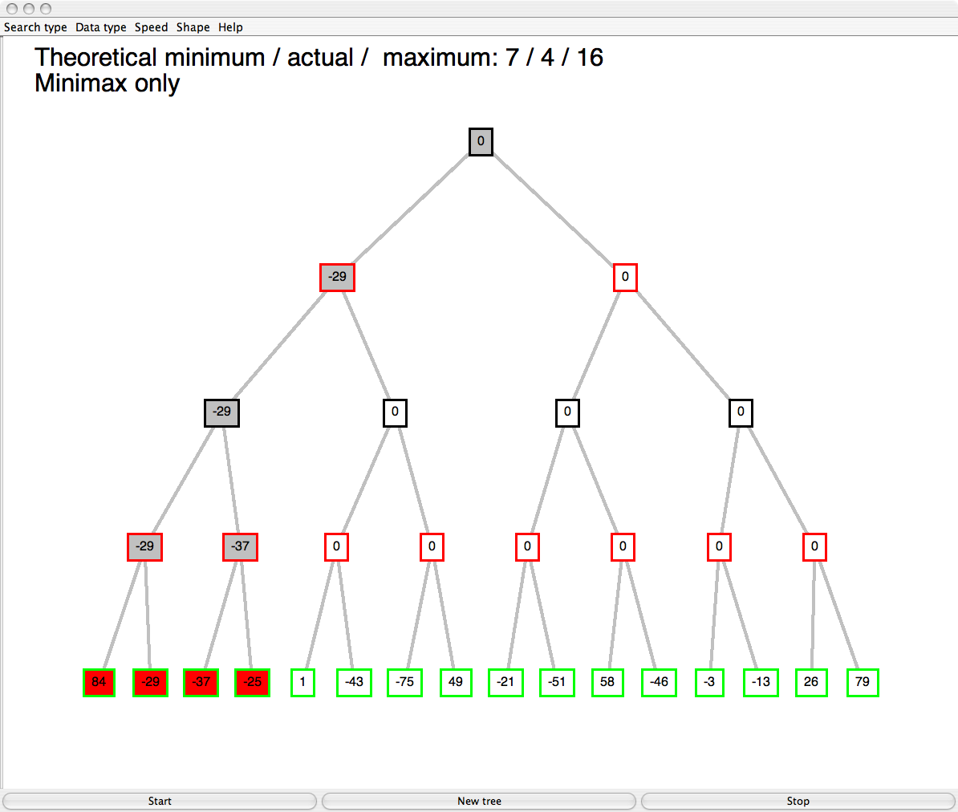
max
min
max
min
© Patrick Winston

Slide 22
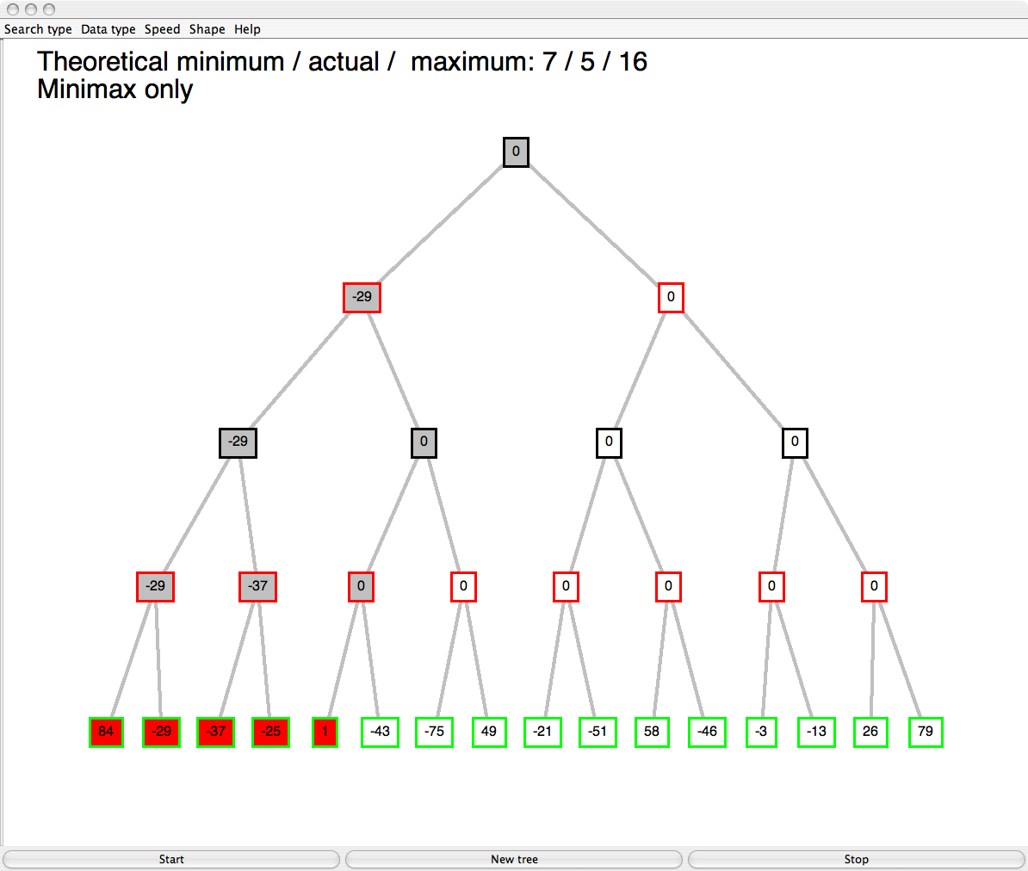
max
min
max
min
© Patrick Winston

Slide 23
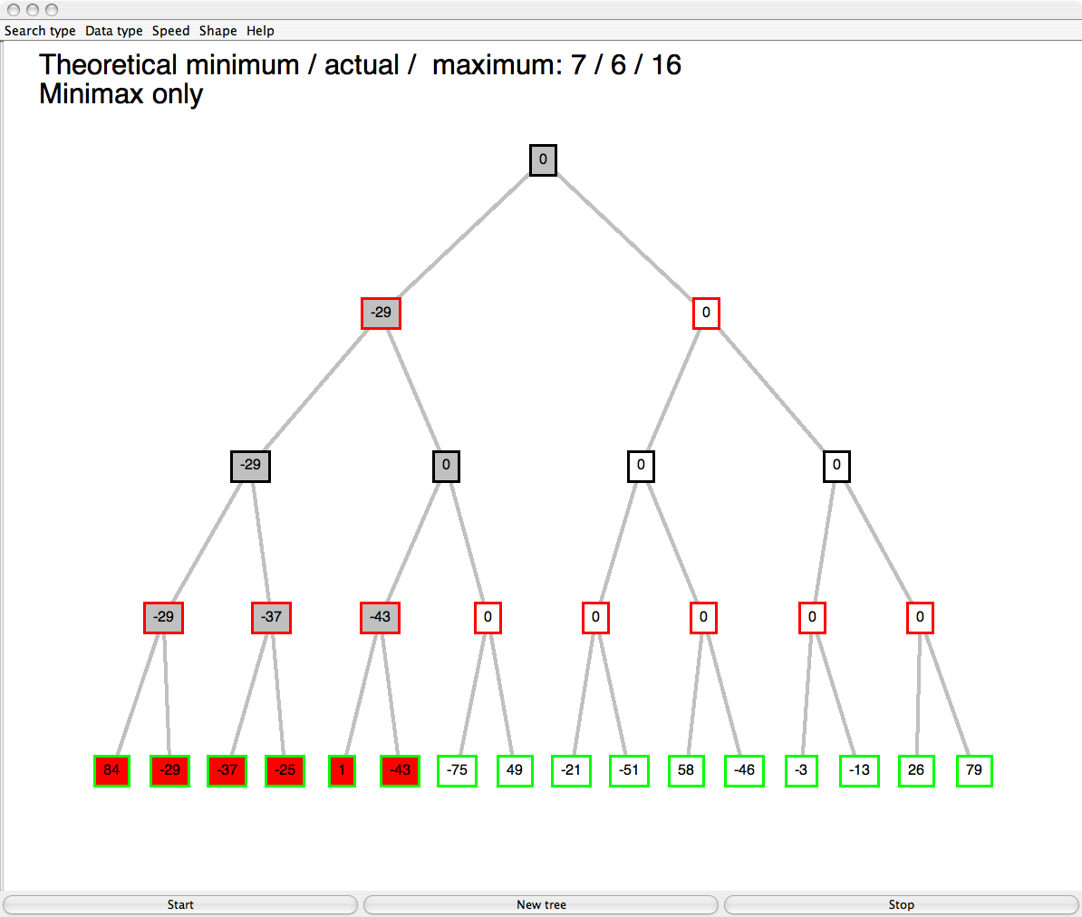
max
min
max
min
© Patrick Winston

Slide 24
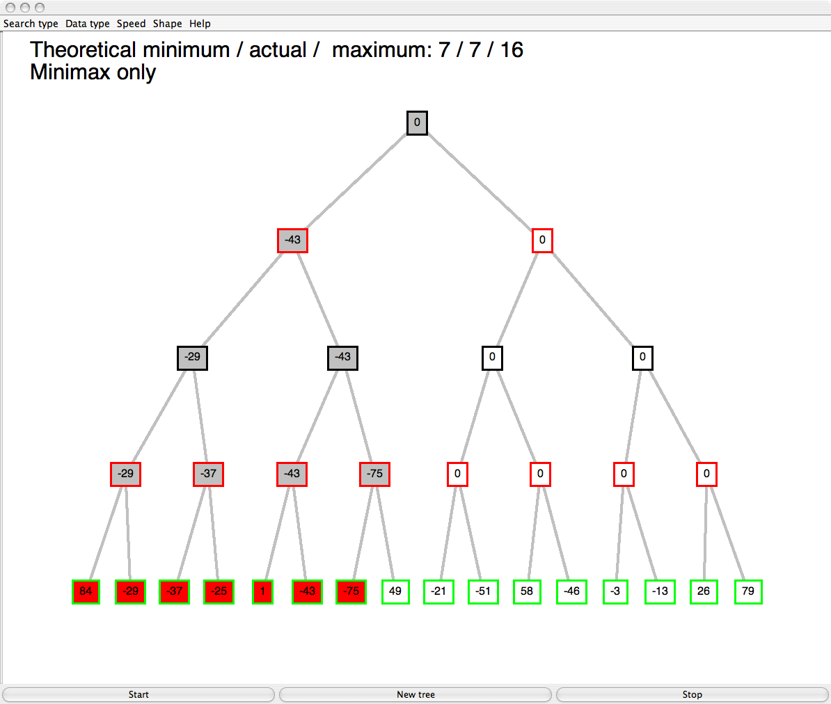
max
min
max
min
© Patrick Winston

Slide 25
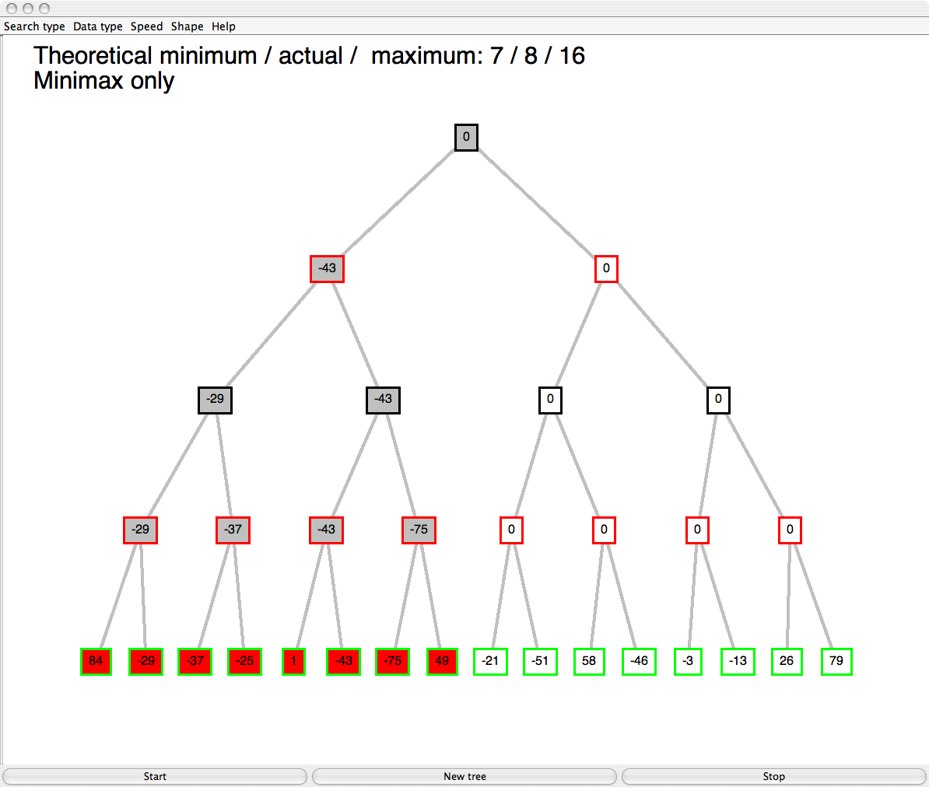
max
min
max
min
© Patrick Winston

Slide 26
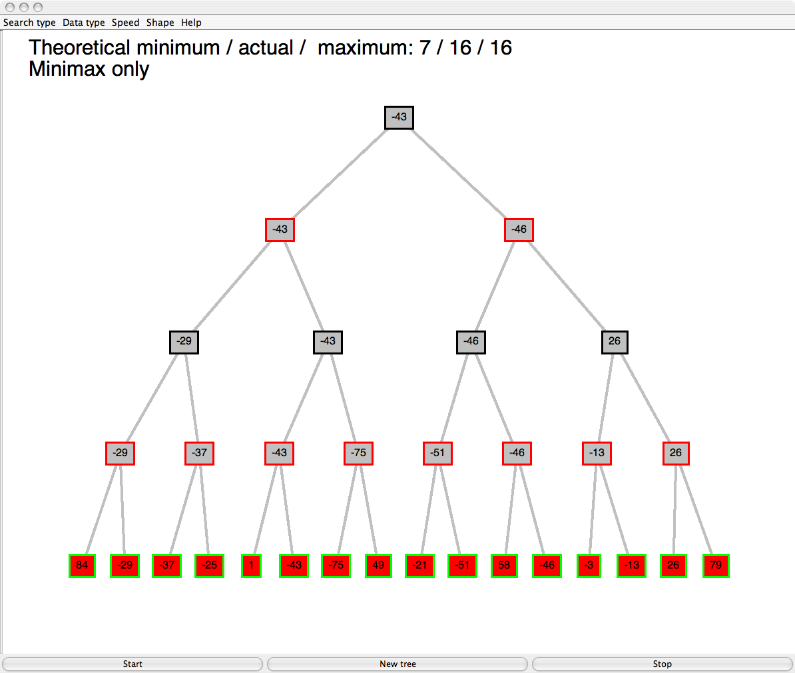
max
min
max
min
© Patrick Winston

Slide 27
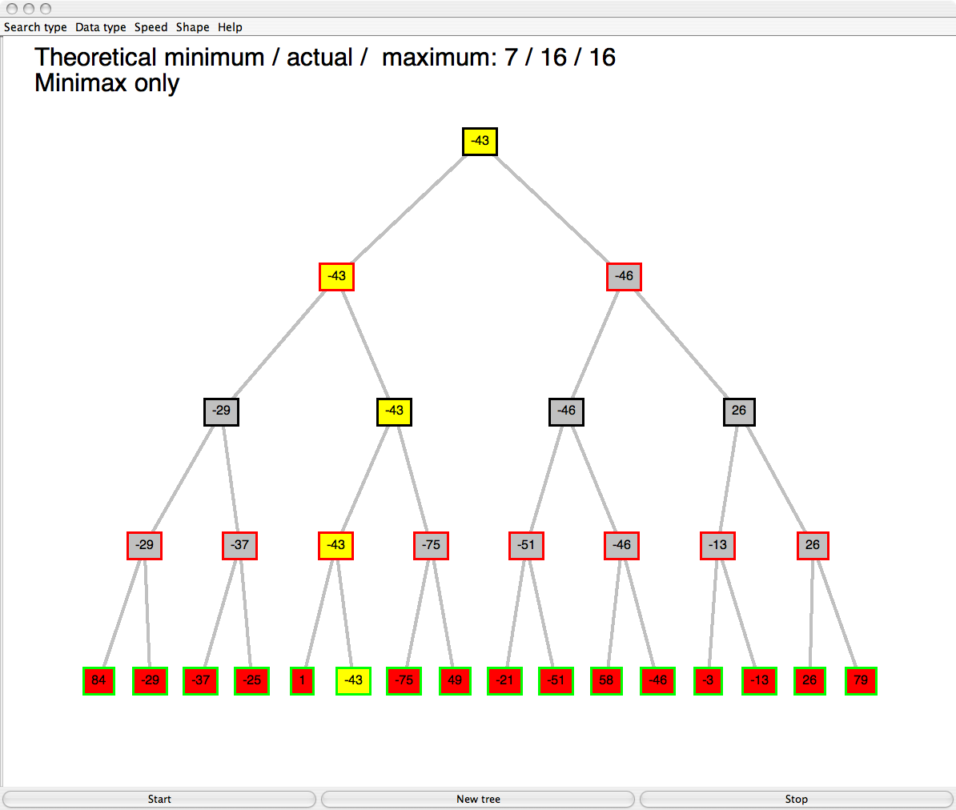
Example 2 - Solution
max
min
max
min
© Patrick Winston

Slide 28
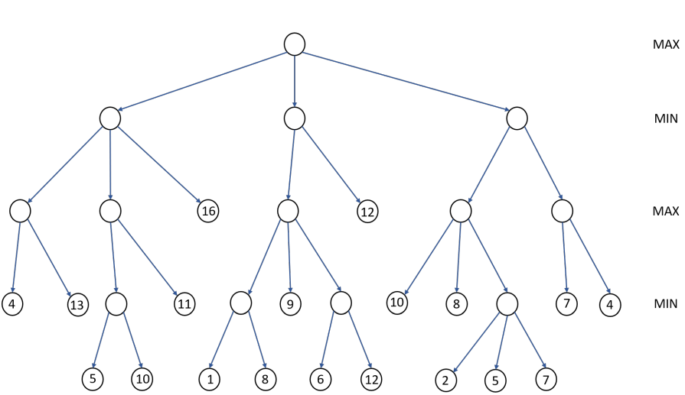
Example 3
Use the Minimax algorithm to compute the minimax value at each node for the game tree below

Slide 29
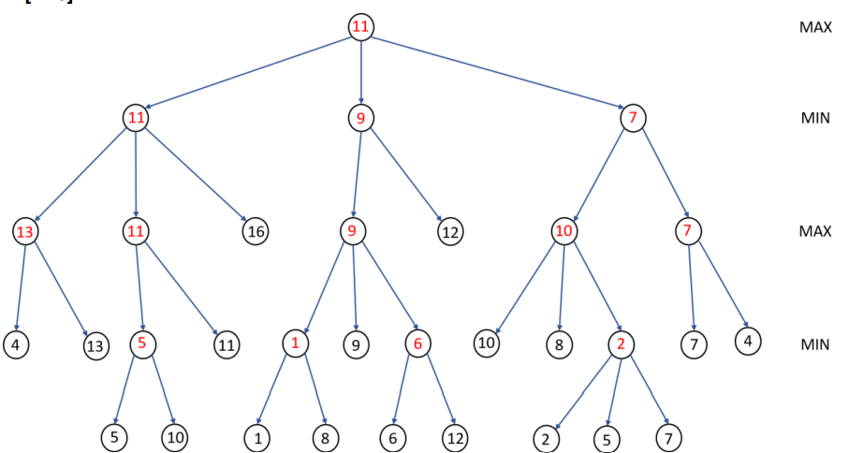
Example 3 - Solution

Slide 30
Alpha-Beta Pruning
A method that optimizes the Minimax algorithm
This involves two threshold parameter Alpha and beta for future expansion, so it is called alpha-beta pruning
The two-parameter can be defined as:
Alpha: The best (highest-value) choice we have found so far at any point along the path of Maximizer. The initial value of alpha is -∞.
Beta: The best (lowest-value) choice we have found so far at any point along the path of Minimizer. The initial value of beta is +∞.

Slide 31
Condition for Alpha-beta pruning: α>=β
The Max player will only update the value of alpha.
The Min player will only update the value of beta.
We will only pass the alpha, beta values to the child nodes.
No values will be sent upwards the tree Depth First Approach with Backtracking.

Slide 32
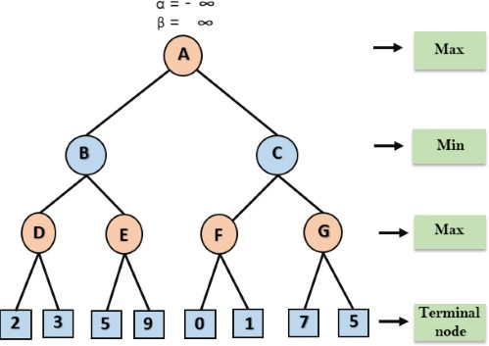
Example 4
The Max player starts at node A, with α = -∞ and β = +∞. These values are passed to node B, where α = -∞ and β = +∞ remain unchanged. Node B then forwards the same values of α and β to its child node D.
The value at Node D will be determined during Max's turn. At Node D,
Notes:
the value is compared against 2 and 3, and the maximum value is chosen. Thus, the value at Node D becomes max(2, 3) = 3, and the node's value will also be 3.
https://tutorialforbeginner.com/alpha-beta-pruning-in-ai

Slide 33



Example 4 – Step 1
The algorithm now returns to node B, where the value will be updated since it is Min's turn.
Notes:
At this point, β = +∞ and it is compared with the value of the available subsequent nodes.
Thus, β = min(∞, 3) = 3. As a result, at node B, α remains unchanged at -∞, while β is updated to 3.

Slide 34
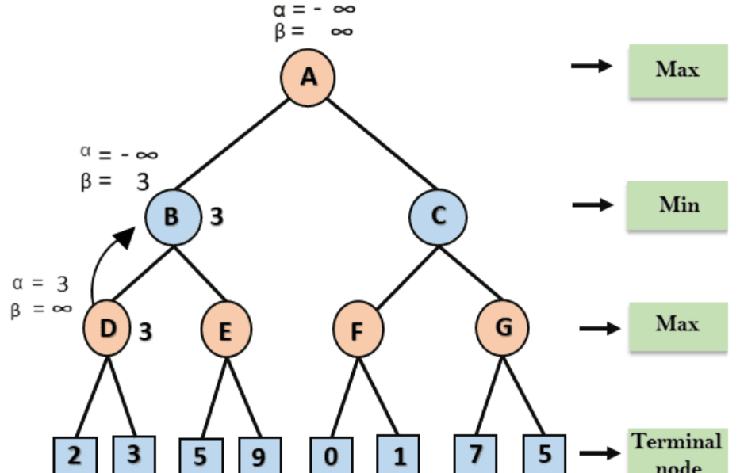
Example 4 – Step 2
Max takes its turn at node E, updating the value of α.
Notes:
The current value of α is compared to 5, resulting in α = max(-∞, 5) = 5.
At node E, α = 5 and β = 3. Since α ≥ β, the right successor of node E is pruned, and the algorithm will not traverse it.
Thus, the value at node E is finalized as 5.

Slide 35
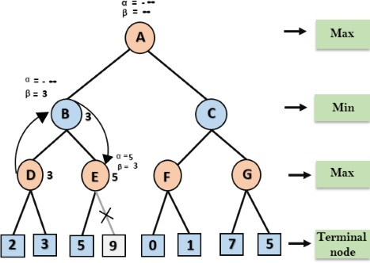
Example 4 – Step 3

Slide 36
Example 4 – Step 4
The method now backtracks in the tree, moving from node B to node A.
At node A, the value of α is updated to the highest available value, resulting in α = max(-∞, 3) = 3, while β remains unchanged at +∞. These updated values, α = 3 and β = +∞, are then passed to A's right successor, node C.
At node C, α = 3 and β = +∞ are forwarded to its child node, F, without any changes.
Notes:
At node A, the value of α is updated to the highest available value, resulting in α = max(-∞, 3) = 3, while β remains unchanged at +∞. These updated values, α = 3 and β = +∞, are then passed to A's right successor, node C.
At node C, α = 3 and β = +∞ are forwarded to its child node, F, without any changes.

Slide 37
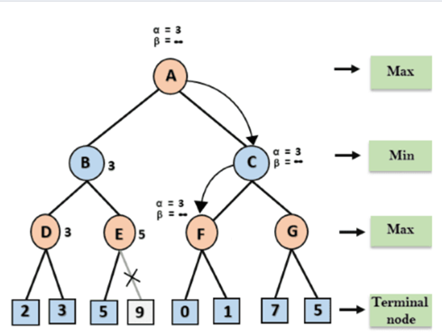
Example 4 – Step 5
At node F, the value of α is compared with its left child, which has a value of 0.
Notes:
The result is α = max(3, 0) = 3. Next, α is compared with the right child, which has a value of 1.
The result remains unchanged as α = max(3, 1) = 3.
However, the node value of F is updated to 1.

Slide 38
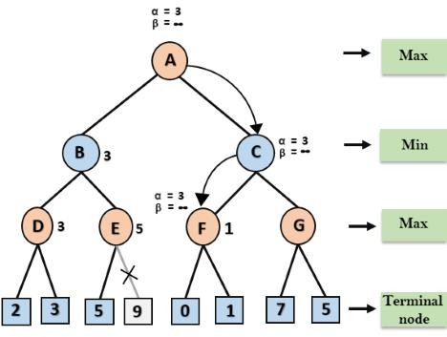
Example 4 – Step 6
Node F returns the node value of 1 to node C
Notes:
At node C, α = 3 and β = +∞.
The value of β is then updated by comparing it with 1, resulting in β = min(+∞, 1) = 1.
Now, at node C, α = 3 and β = 1.
Since the condition α ≥ β is met, the algorithm prunes the next child of node C, which is G, and does not compute the entire subtree of G.

Slide 39
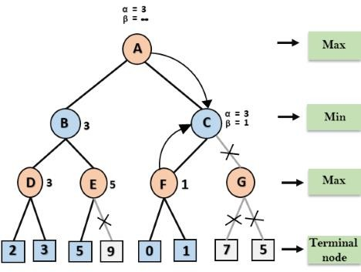
Example 4 – Step 7
Node C returns the value of 1 to node A
Notes:
Node C returns the value of 1 to node A.
At node A, the algorithm calculates the maximum value between the current value of α and the value returned from node C, resulting in
α = max(3, 1) = 3.
This becomes the greatest result for node A. The completed game tree, which displays both computed and pruned nodes, reveals that the best value for the maximizer in this case is 3.

Slide 40
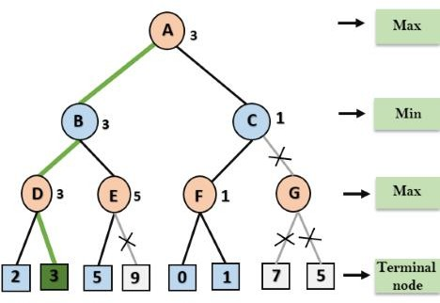
Example 4 - Solution
Notes:
https://tutorialforbeginner.com/alpha-beta-pruning-in-ai

Slide 41
Example 5
max
min
max
min

Slide 42
Example 5 - Solution
max
min
max
min

Slide 43
max
min
max
min

Slide 44
max
min
max
min
© Patrick Winston

Slide 45
max
min
max
Do we need to check
this node?
min
??

Slide 46
max
min
max
No - this branch is guaranteed to be worse than what max already has
min
X

Slide 47
Alpha-Beta
MinVal(state, alpha, beta){
if (terminal(state))
return utility(state);
for (s in children(state)){
child = MaxVal(s,alpha,beta);
beta = min(beta,child);
if (alpha>=beta) return child;
}
return beta; }
alpha = the highest value for MAX along the path
beta = the lowest value for MIN along the path

Slide 48
Alpha-Beta
MaxVal(state, alpha, beta){
if (terminal(state))
return utility(state);
for (s in children(state)){
child = MinVal(s,alpha,beta);
alpha = max(beta,child);
if (alpha>=beta) return child;
}
return beta; }
alpha = the highest value for MAX along the path
beta = the lowest value for MIN along the path

Slide 49
max
α=-∞
β=∞
α - the best value
for max along the path
β - the best value
for min along the path
min
α=-∞
β=∞
max
α=-∞
β=∞
min
α=-∞
β=84

Slide 50
max
α=-∞
β=∞
α - the best value
for max along the path
β - the best value
for min along the path
min
α=-∞
β=∞
max
α=-29
β=∞
min
α=-∞
β=-29
α=-29
β=∞

Slide 51
max
α=-∞
β=∞
α - the best value
for max along the path
β - the best value
for min along the path
min
α=-∞
β=∞
max
α=-29
β=∞
min
α=-∞
β=-29
α=-29
β=-37

Slide 52
max
α=-∞
β=∞
α - the best value
for max along the path
β - the best value
for min along the path
min
α=-∞
β=∞
max
α=-29
β=∞
β < α
prune!
min
α=-∞
β=-29
α=-29
β=-37
X

Slide 53
max
α=-∞
β=∞
α - the best value
for max along the path
β - the best value
for min along the path
min
α=-∞
β=-29
max
α=-29
β=∞
α=-∞
β=-29
min
α=-∞
β=-29
α=-29
β=-37
α=-∞
β=-29
X

Slide 54
max
α=-∞
β=∞
α - the best value
for max along the path
β - the best value
for min along the path
min
α=-∞
β=-29
max
α=-29
β=∞
α=-∞
β=-29
min
α=-∞
β=-29
α=-29
β=-37
α=-∞
β=-29
X

Slide 55
max
α=-∞
β=∞
α - the best value
for max along the path
β - the best value
for min along the path
min
α=-∞
β=-29
max
α=-29
β=∞
α=-43
β=-29
min
α=-∞
β=-29
α=-29
β=-37
α=-∞
β=-43
α=-43
β=-29
X

Slide 56
max
α=-∞
β=∞
α - the best value
for max along the path
β - the best value
for min along the path
min
α=-∞
β=-29
max
α=-29
β=∞
α=-43
β=-29
β < α
prune!
min
α=-∞
β=-29
α=-29
β=-37
α=-∞
β=-43
α=-43
β=-75
X
X

Slide 57
max
α=-43
β=∞
α - the best value
for max along the path
β - the best value
for min along the path
min
α=-∞
β=-43
max
α=-29
β=∞
α=-43
β=-29
min
α=-∞
β=-29
α=-29
β=-37
α=-∞
β=-43
α=-43
β=-75
X
X

Slide 58
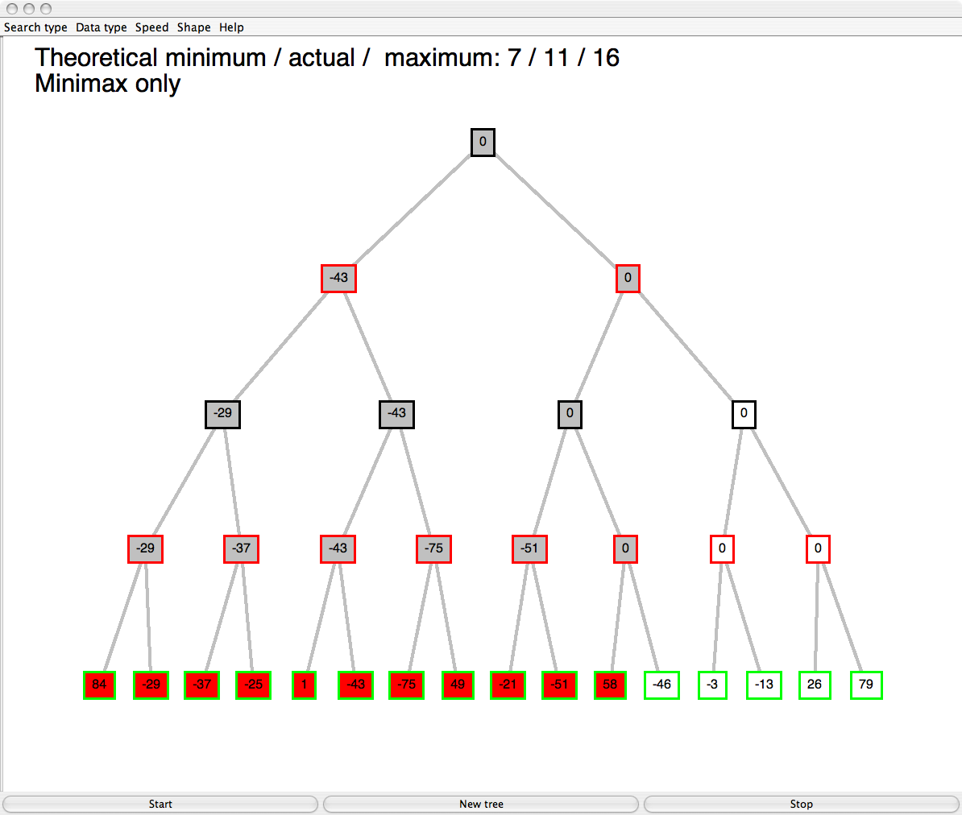
max
α=-43
β=∞
α - the best value
for max along the path
β - the best value
for min along the path
min
α=-43
β=∞
max
α=-43
β=∞
min
α=-43
β=-21
α=-43
β=58
X
X

Slide 59
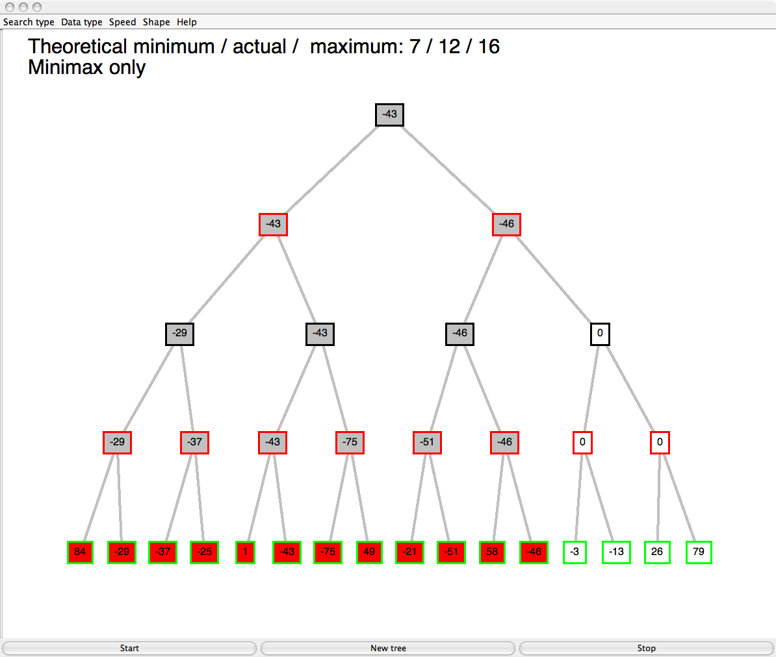
max
α=-43
β=∞
α - the best value
for max along the path
β - the best value
for min along the path
β < α
prune!
min
α=-43
β=-46
α=-43
β=∞
X
max
α=-43
β=-21
α=-43
β=-46
X
X
min
X
X
X
X
X
X

Slide 60
Example 6
Use the alpha beta pruning algorithm for the game tree below

Slide 61
Examples
https://pywix.blogspot.com/2020/05/alpha-beta-pruning-in-artificial.html
https://tutorialforbeginner.com/alpha-beta-pruning-in-ai
https://www.youtube.com/watch?v=egNkn_-uelA
https://www.youtube.com/watch?v=DCNP5L9_t4E
https://pages.cs.wisc.edu/~dyer/cs540/hw-toc.html - IMP

